Slide 1
JLogics
Snapshots

Slide 2
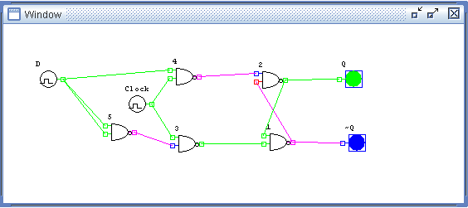
D-Flip Flop

Slide 3
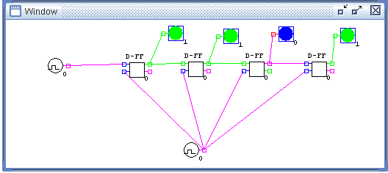
Shift Register – 4 Bits , Showing 1101

Slide 4
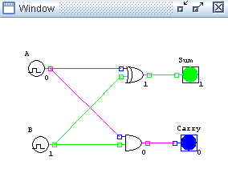
Half Adder

Slide 5
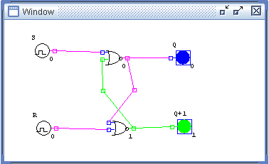
RS-Flip Flop

Slide 6
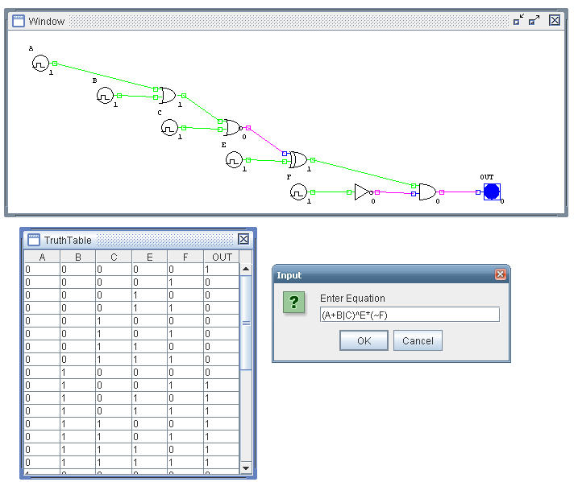
Circuit (A+B|C)^E*(~F) – (A OR B NOR C) XOR E AND (NOT F)

Slide 7
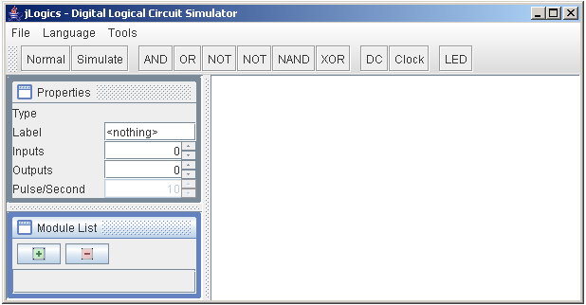
Snapshot of English Version

Slide 8
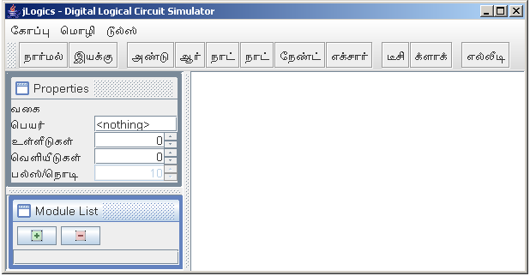
Snapshot of Tamil Version

Slide 9
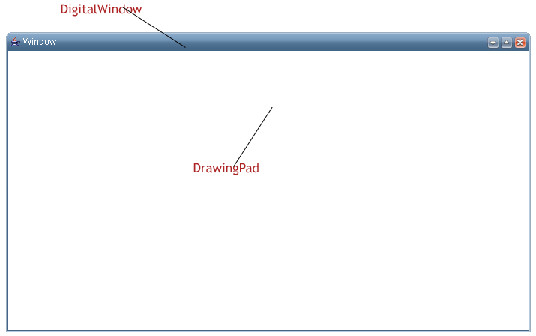
Snapshot of Drawingpad

Slide 10
Snapshot of Toolbar

Slide 11
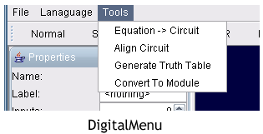
Snapshot of Menubar

Slide 12
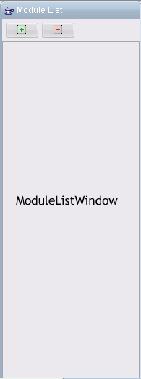
Snapshot of Module List window

Slide 13
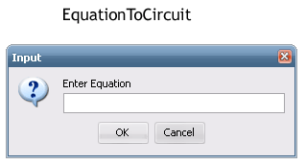
Snapshot of Equation to Circuit Window

